Slide 1



Team Name : CyberKnight5
Team Leader : Savneet Kaur Chhatwal
chhatwal_savneet.ghrcecs@raisoni.net
G. H. Raisoni College of Engineering
Nagpur
Smart India Hackathon 2018
Ministry/state
Government of Chandigarh
Sector : Education & Skills
Software
Student Mobile App
Problem Code: #GCH2 College Code: #7485

Slide 2
Problem abstract
Provide information/data regarding the particular college.
State/Centrally sponsored schemes and events.
Track attendance (by students, teachers and parents).
Provide important information and updates e.g. circulars, results, exam dates, timings, etc.
Library book return reminder.
Login with roll number/id number.
Allow parents to track their ward's attendance and performance.
Share documents like domicile and bonafide.
Connected to Central Governmental database.
Connected with AADHAR to enable verification of documents.
Get data of any student anywhere like:
State -> University -> College -> Student
Notes:
Can you make Points smaller

Slide 3



Clavi
Clavi
Clavi
P
T
An all-in-one,cross-platform college management app.

Slide 4
Features
User | College information | Personal Info | Academic info | Forum for Teacher Parent Talk | College notifications | Documents (TC,bonafide,etc) | Canteen | Govt. Sponsored Schemes | Request Info. from other college
Parents/ Students | View | View | View | Yes | View | View and request | Yes | View | No
Teachers | View | View and Edit | View and Edit | Yes | View and Edit | View and request | Yes | View | Yes
College Admins | View and Edit | View and Edit | View and Edit | Yes | View and Edit | View and request | Yes | View | Yes
University Admins | View and Edit | View | View on Request | No | No | View on Request | No | View | Yes
Govt. Admin | View and Edit | View | View on Request | No | No | View on Request | No | View and Edit | Yes
Notes:
I think We can Remove 4th As 4th and 6th are same just to reduce slides

Slide 5
Current Market Scene
Our Specialities
Student’s assistant for everything
Device independent
Cross platform
Centralised Database
Aadhar Integration
Teacher-parent interaction
SMS notification
We observed that very few apps are available which can solve the problems only partially.
For eg:
GHRCE STUDENT DIARY APP: attendance, results and course details of students.
MY STUDY LIFE: Schedule

Slide 6
FUTURE SCOPE
Face-recognition based attendance
Monthly performance analysis
Faster approval of scholarships
Better understanding of Youth Mentality

Slide 7
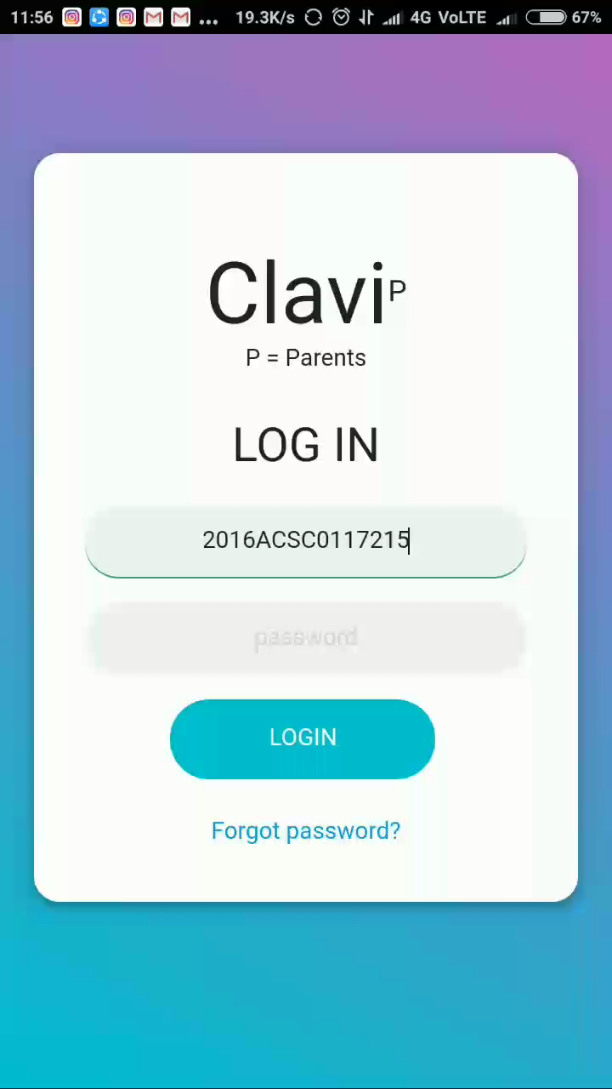
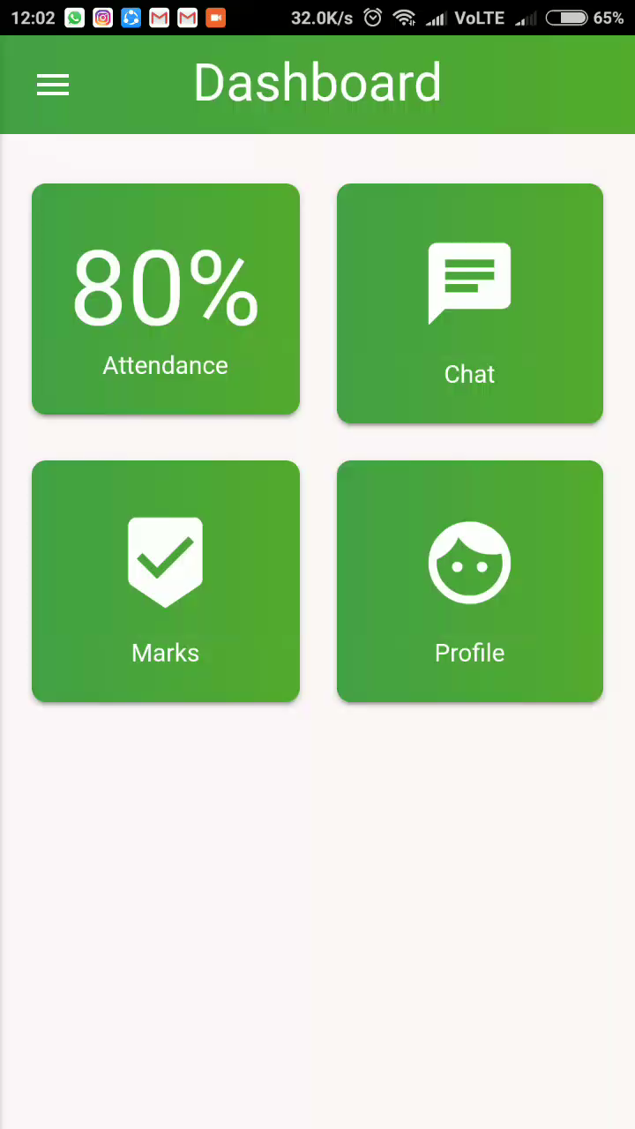

Slide 8
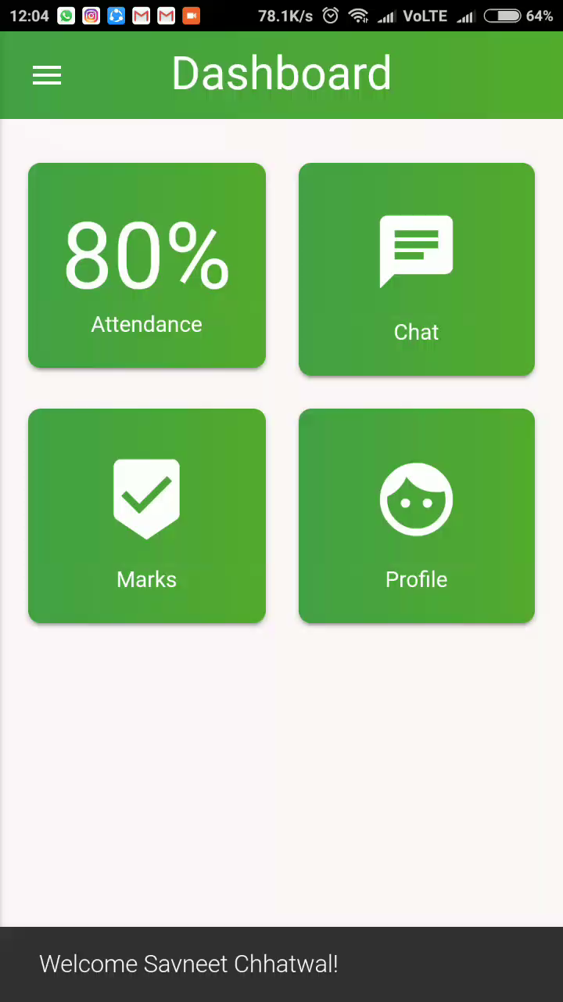
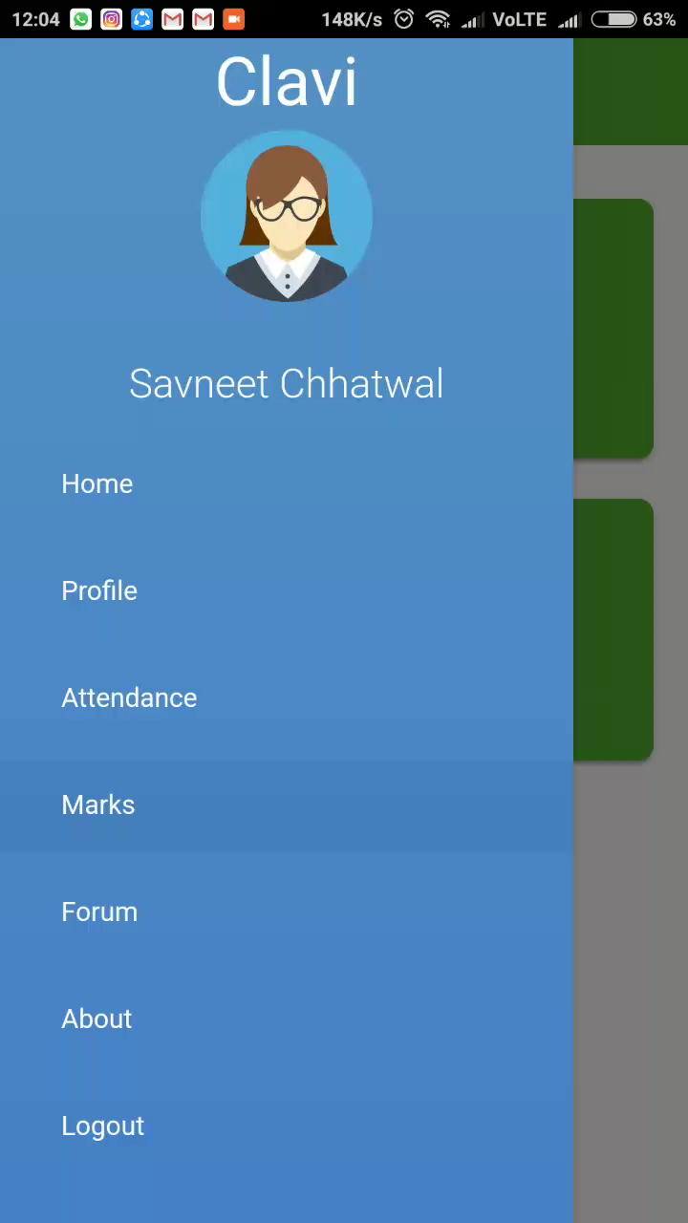

Slide 9
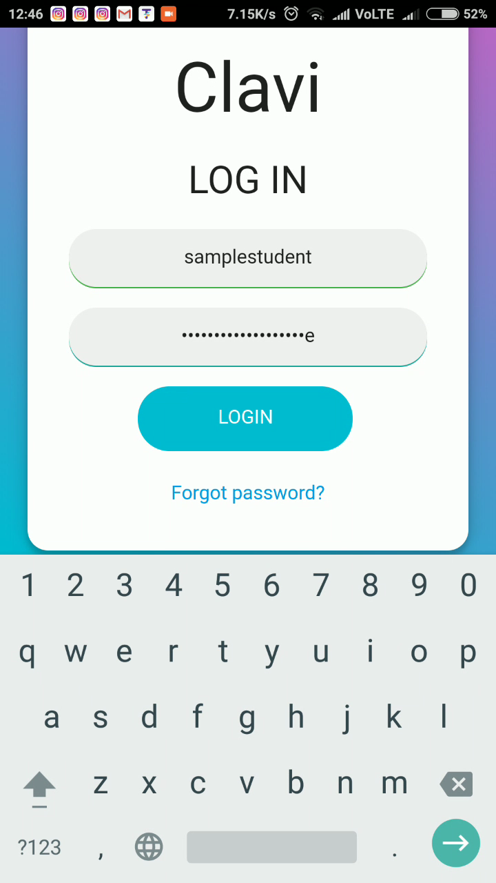
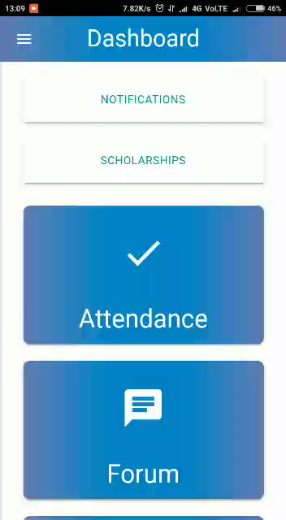

Slide 10
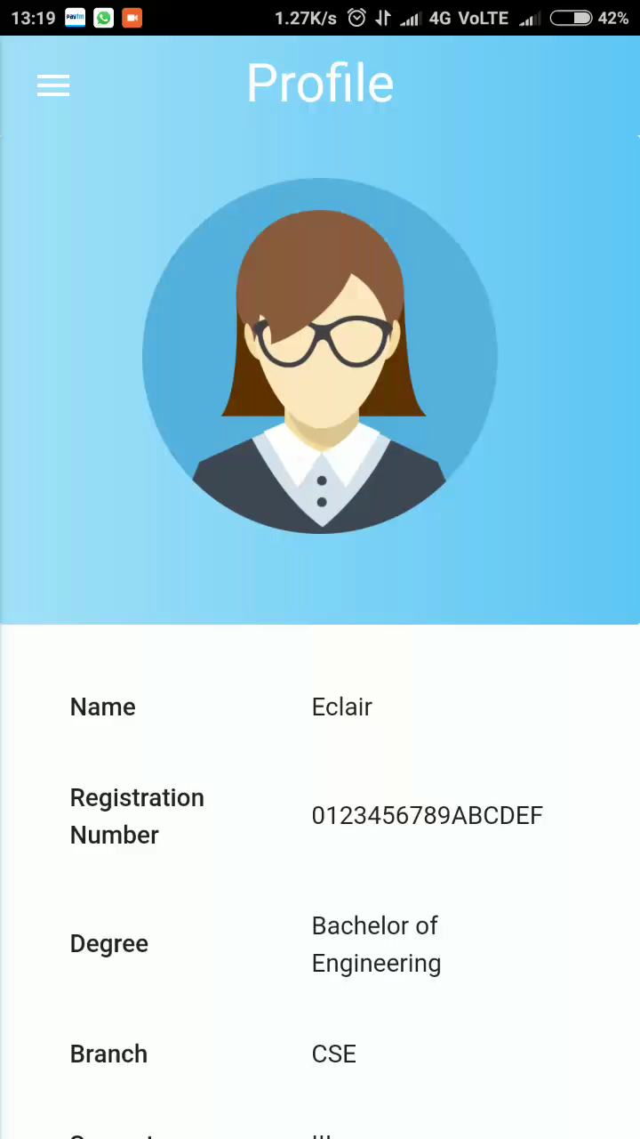

Slide 11
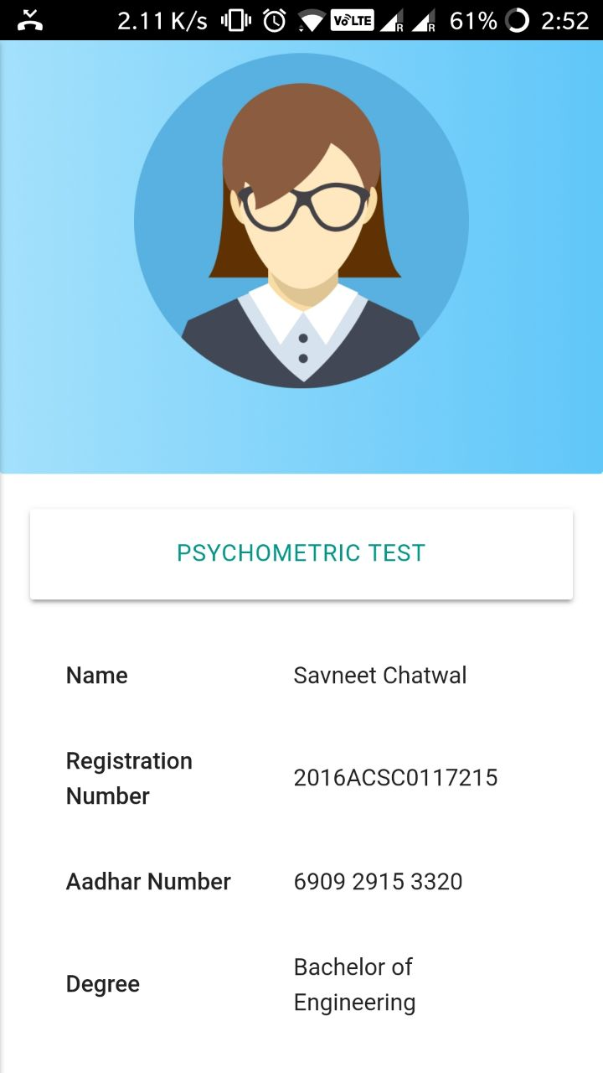
Sentimental Analysis
Through psychometric test

Slide 12
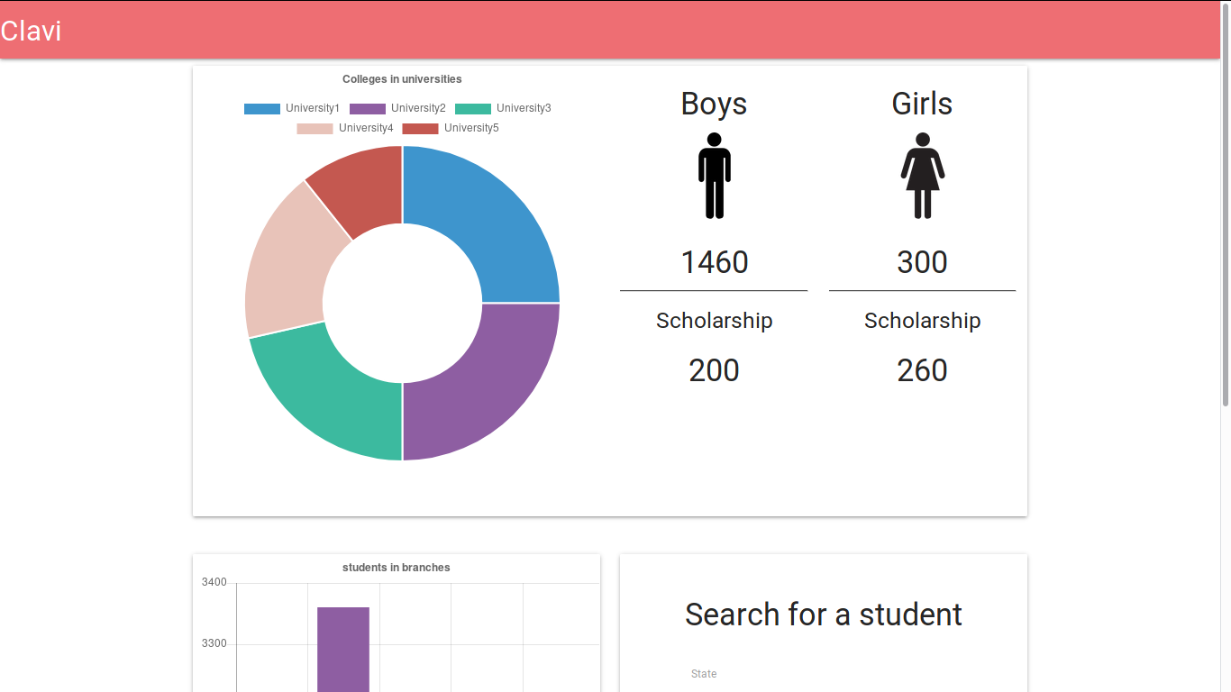

Slide 13
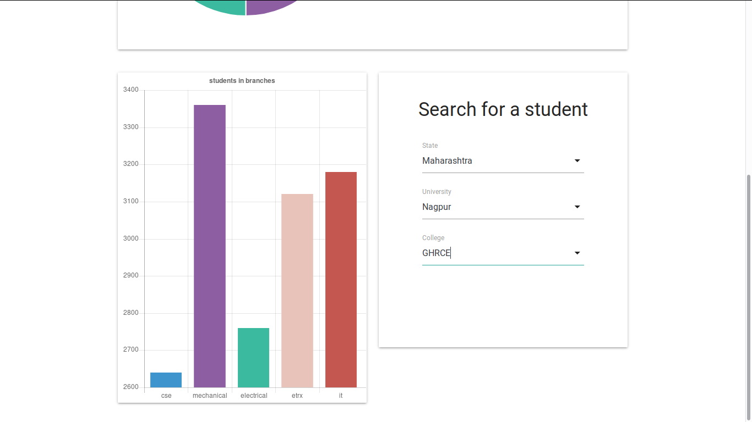

Slide 14
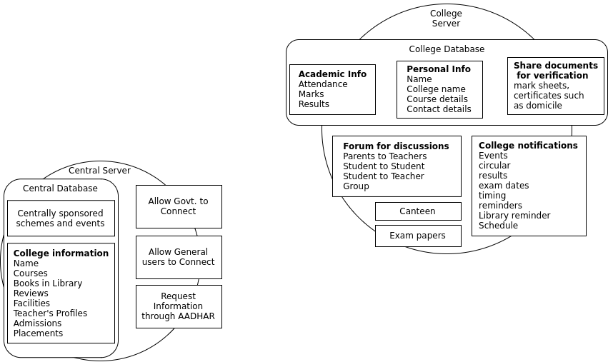
Clavi
Structure
What is Clavi Personal Assistant?
It can talk to you
Assess and track your academic performance
Motivating reminders to improve your performance
Personalized only for you

Slide 15
Technical Specifications and Requirements
Application
Cross platform hybrid application
Based on web technologies
Login from any device
Native wrapper provided by Phonegap
Design framework provided by Materialize
Devices
Central server
Institutional server
Mobile devices as clients
Desktop computers as clients
Desktop computers for special tasks like canteen
Server
Nodejs Runtime
Linux based operating system (Recommended)
SQL DB or MongoDB (MongoDB is preferred)
Other Requirements
Internet Connection

Slide 16


